Slide 1
The AIDS Crisis
Dr S. Walker,
Glasgow Caledonian University
Notes:
1

Slide 2
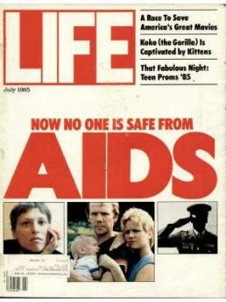

Contents
AIDS and HIV in history
A medical crisis and moral panic – US / UK
AIDS in Culture and Society
Turning the Tide – Attempts at Public Education
Notes:
2

Slide 3
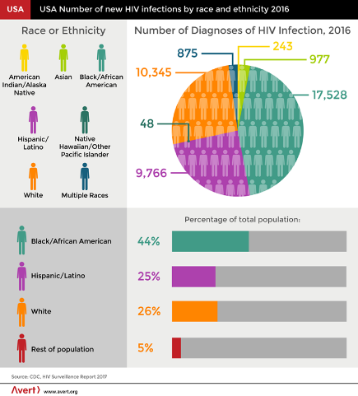
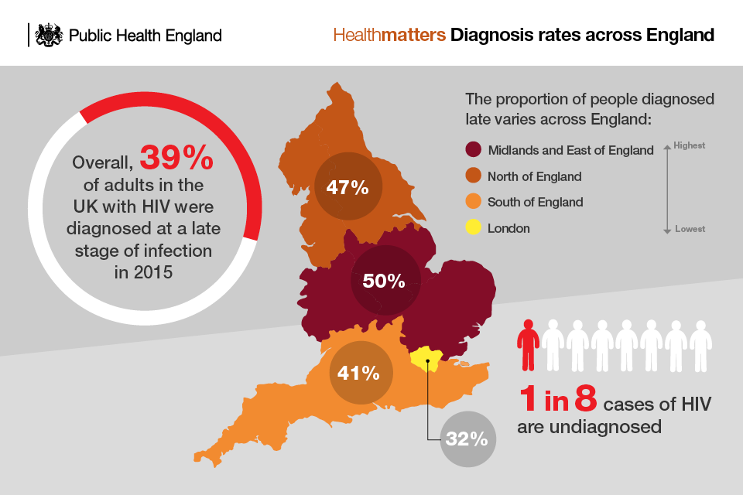
What is HIV?
HIV - Human Immunodeficiency Virus
Transmission through bodily fluids
AIDS: Immunodeficiency Syndrome
https://www.avert.org/professionals/hiv-around-world/western-central-europe-north-america/usa
https://www.gov.uk/government/publications/health-matters-increasing-the-uptake-of-hiv-testing/health-matters-increasing-the-uptake-of-hiv-testing

Slide 4
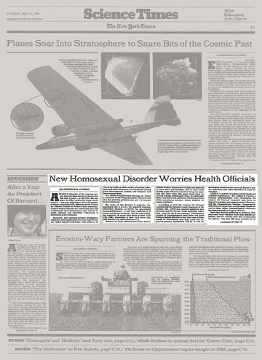
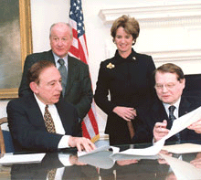
AIDS in History
June 5, 1981, first reports of five homosexual men deaths from pneumonia in LA.
GRID (Gay-Related Immune Deficiency)
4-H Disease (heroin users, homosexuals, haemophiliacs and Haitians)
In 1982 CDC coined the term AIDS to describe the syndrome
Luc Montagnier (right) of the Pasteur Institute and Robert C. Gallo (left) at the National Cancer Institute in Bethesda
Lawrence K. Altman, ‘New Homosexual Disorder Worries Health Officials’, New York Times, (May 11, 1982), Section C, p.1.
Collaboration after court case in 1986

Slide 5
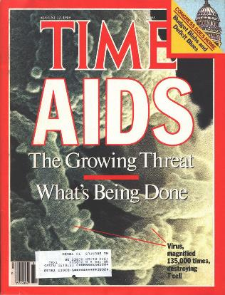
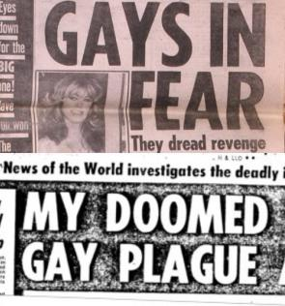
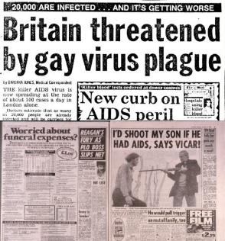
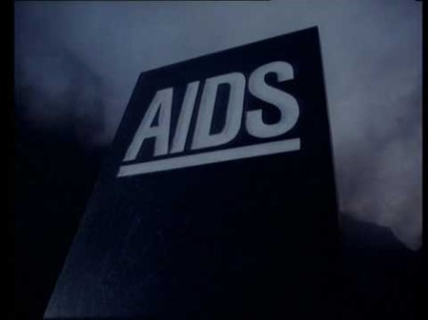
Immediate Public Reaction
Fear and lack of understanding
Anger and Blame
Mistrust and Misinformation
Discrimination
Controversial ‘AIDS tombstone advert’, British Government, UK, 1985,

Slide 6


Differing Approaches – US / UK
1982 – 84 – Death toll rises significant from 853 to 4251 per year.
Criminalisation of drug users
Mixed messages for the Public
In 1982, Larry Speakes, press secretary for Reagan, laughed when asked about whether the president was tracking the spread of AIDS
1984 - 46 deaths in the UK
By 1991, AIDS is reported in 51 countries
1985 – Established Expert Advisory Group on AIDS (EAGA) (last meeting 2014).
Significant focus on Drug Users and Wide Public Awareness
Notes:
6

Slide 7

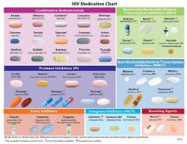
Early Medical Treatment and Research
GLOBAL HIV STATISTICS
26 million [25.1 million–26.2 million] people were accessing antiretroviral therapy as of the end of June 2020.
38.0 million [31.6 million–44.5 million] people globally were living with HIV in 2019.
1.7 million [1.2 million–2.2 million] people became newly infected with HIV in 2019.
690 000 [500 000–970 000] people died from AIDS-related illnesses in 2019.
75.7 million [55.9 million–100 million] people have become infected with HIV since the start of the epidemic (end 2019).
32.7 million [24.8 million–42.2 million] people have died from AIDS-related illnesses since the start of the epidemic (end 2019).
1987 - Azidothymidine, also known as zidovudine.
1997 - highly active antiretroviral therapy (HAART)
2002 - The Food and Drug Administration (FDA) approved the first rapid HIV diagnostic test kit
https://www.unaids.org/en/resources/fact-sheet

Slide 8
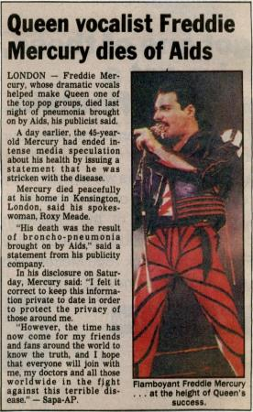
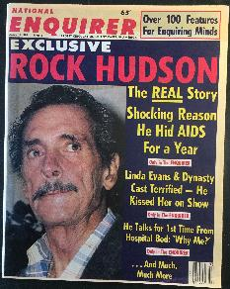

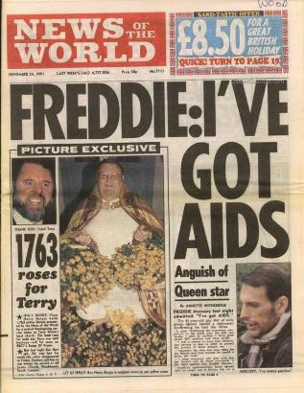

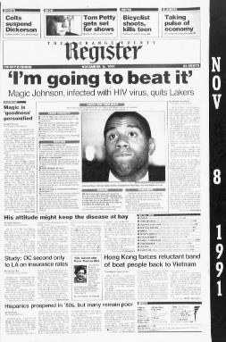

Culture and Society
Fear and Misunderstanding
Mixed Messages
High Profile Deaths
The Gay Plague
Drugs and Criminals

Slide 9

Culture and Society
Fear and Misunderstanding
Mixed Messages
High Profile Deaths
The Gay Plague
Drugs and Criminals

Slide 10


Turning the Tide – New Understanding
Fighting against a tide of Misinformation and homophobia
Celebrity and Media Activism
Education and Public Support
The AIDS Coalition to Unleash Power, better known as ACT UP, was formed in 1987 to protest the government’s slow response to the AIDS crisis. In honour of LGBTQ History Month, NBC OUT looks back at its legacy. 2016
The Crown s4 – 2020.

Slide 11
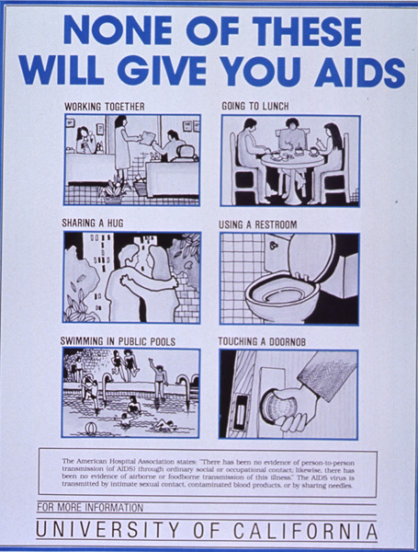
Conclusion
New disease which created a global society and moral panic.
US / UK governments dealt with the disease in different ways as a result of existing social and health care systems
Fear of AIDS had lasting implications on society and those considered most at risk
Key figures had a positive impact on the perception of AIDS but fear and stigma continues.
Notes:
11

